Slide 1
VRAgent: An Agent-based Tool for Automated VR GUI Testing
Reporter: Zhengyang Zhu

Slide 2

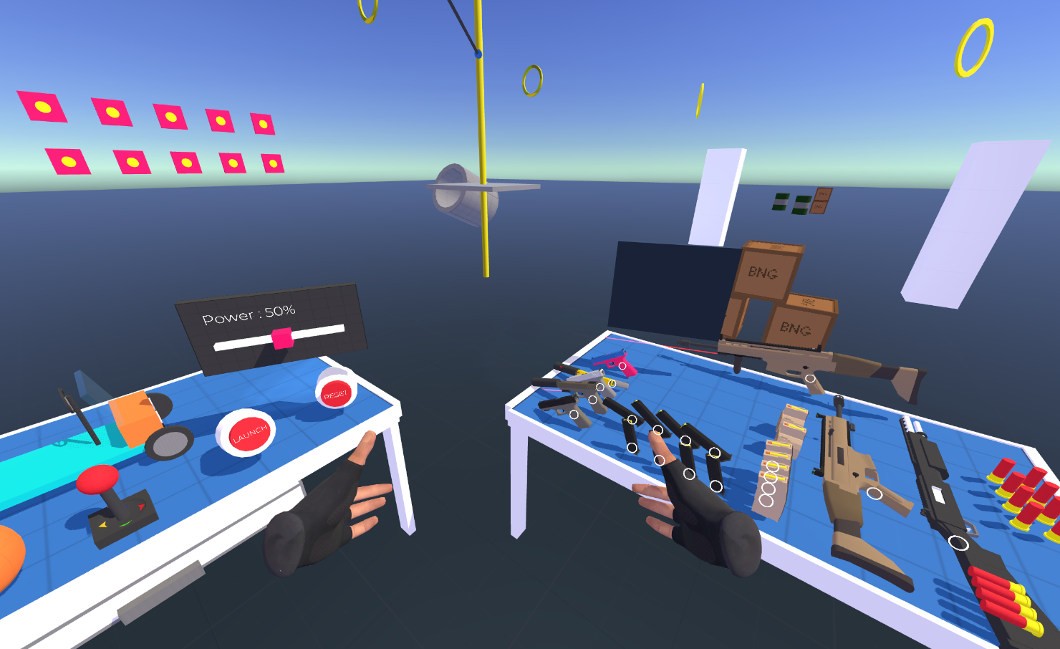
Research Background
Virtual Reality(VR) is a computer-based technology that simulates visual, auditory, and tactile effects of an artificially created environment, aiming to immerse the user in a perceived reality.
Most of the VR apps are developed by Unity3D (one of the most popular game engines). Undeniably, there are many bugs during the developing procedure.

Slide 3
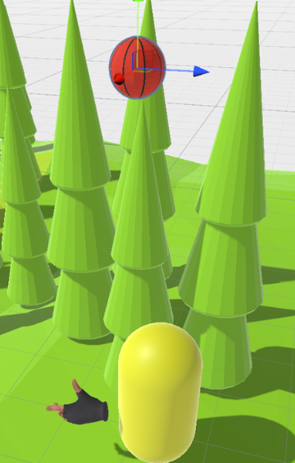
Motivation
Functional Bug:
Unity Console Error(e.g., Null Reference)
Scene Vulnerabilities(e. g., Incorrectly setting the user gravity property of objects that should be affected by gravity(e.g. basketball) to false can lead to unsatisfactory physical interaction effects.
Component Compatibility Errors
The testing of VR applications is currently mainly manual testing, which is very labor-intensive and time-consuming.

Slide 4
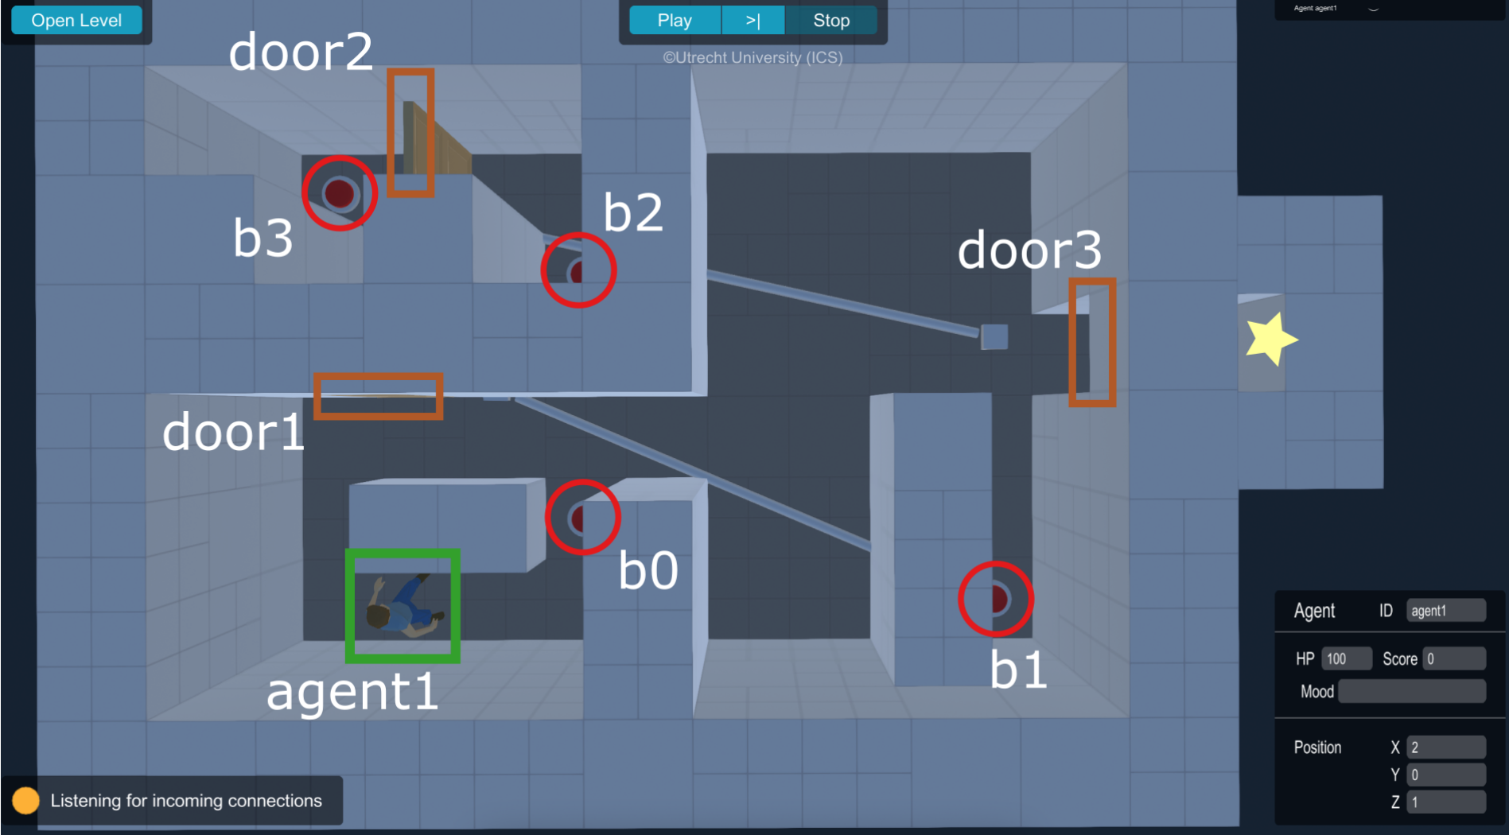
Challenges and Difficulties
Sota tools:
exhibit limited performance in scene exploration
can not access complicated task sequences
cannot be migrated to other types of games.
unable to provide a general VR tool to detect different types of VRAPPs
unsensible to heuristic functional bugs(e.g. Scene Vulnerabilities)

Slide 5
Methodology
1. Data Collection
Construct a Unity open-source VR project data set;
Result: Github 971 repo; After manifest validation and manual check, 104 quality repo
After complied, bug characteristics analysis + root cause analysis
2. Scene Exploration: Combination of Entity-Action-Task Model and Agent-Based Approaches
Navigation Module: Pre-Baked NavMesh + NavmeshAgent;
Shortest Hamiltonian Path Problem: Algorithms based on (1). Greedy, (2).Backtracking-branch and bound pruning, (3). State Compression Dynamic Programming for optimizing global pathfinding problems;
Entity-Action-Task Model：(1) Base Entity interface for abstracting different VR MonoBehaviour Class (2). Base Action class for abstracting indivisible action of VRAgent (3). Task Generator for generating List<BaseAction> result of the input BaseEntity[];
Agent-Based (to-do)：(1).basic FSM (2). Reinforcement Learning Approach (3). Optimize Policy: PPO、SAC、TD3、DDPG;
3. Evaluation
Experiment: Backtracking to versions before specific bugs are fixed in the git repository commit history;
Metrics: State Coverage(SC), Interactable Objects Coverage (IOC), Method Coverage(MC) and Physical Interaction Coverage (PIC) ;

Slide 6
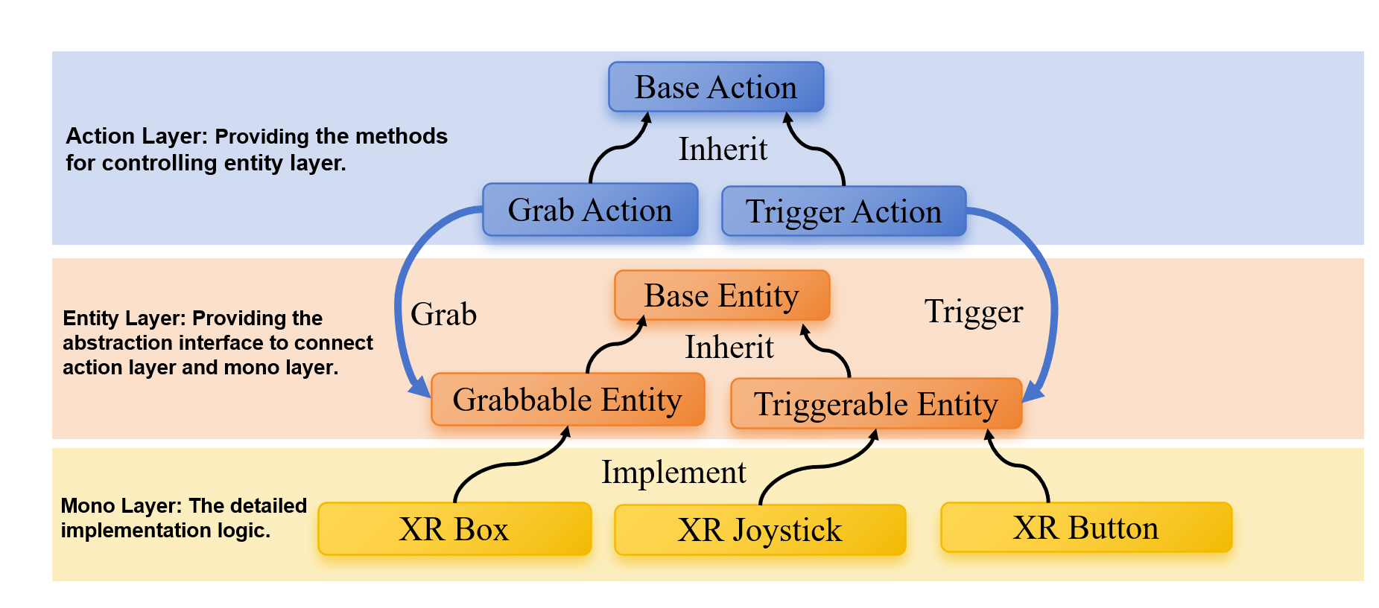
Entity-Action-Task Model
We designed an Entity-Action-Action Model to describe the interaction in VR scenes better.
BaseEntity: interface
Definition: a terminal interface used for binding to the MonoBehaviour-Derived class
BaseAction: class
Definition: BaseAction is an indivisible and fundamental action class, particularly representing an asynchronous function that the VRAgent can perform.

Slide 7

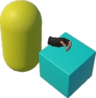




Task Layer: Providing predefined tasks through linear and nonlinear combinations of actions.
Task Instance
Grab-And-Shoot-Gun Task
Task Generator
Parallel Action
Move Action
Grab Action
List<BaseAction> GetTask(BaseEntity[] e);
Move Action
Move Action
Trigger Action
Trigger Action
Trigger Action
Input
Output
Asynchronous Action
Instance
$${Entity}_{1}$$
$${Action }_{1}$$
Grab-And-Drag-Box Task
…
Generate
…
Parallel Action
Move to approcach
$${Entity}_{m}$$
$${Action }_{n}$$
Move Action
Grab Action
Grab
Move Action
Asynchronous Action
Walk Around
Base Action
Action Layer: Providing parameterized methods for controlling entity layer.
Inherit
Grab Action
Trigger Action
Grab
Base Entity
Trigger
Entity Layer: Providing the abstraction interface to connect action layer and mono layer.
Inherit
Grabbable Entity
Triggerable Entity
Implement
Mono Layer: The detailed implementation logic.
XR Box
XR Button
XR Joystick

Slide 8




Task Generator
Task Instance
List<BaseAction> GetTask(BaseEntity[] e);
Grab-And-Shoot-Gun Task
Input
Output
Parallel Action
Instance
Move Action
Grab Action
$${Entity}_{1}$$
$${Action }_{1}$$
Move Action
Move Action
…
Generate
…
Trigger Action
Trigger Action
Trigger Action
$${Entity}_{m}$$
$${Action }_{n}$$
Asynchronous Action
Code Description
private List<BaseAction> GrabAndShootGunTask(
IGrabbableEntity grabbableEntity, ITriggerableEntity triggerableEntity){
List<BaseAction> task = new List<BaseAction>(){
new MoveAction(_navMeshAgent, moveSpeed, grabbableEntity.transform.position),
new GrabAction(leftHandController, grabbableEntity, new List<BaseAction>(){
new ParallelAction(new List<BaseAction>(){
new MoveAction(_navMeshAgent, moveSpeed, GetRandomTwitchTarget(transform.position)),
new TriggerAction(0.5f, triggerableEntity)
})
})
};
return task;
}

Slide 9
Related Work
(ICSE '22)短文 VRTest: An Extensible Framework for Automatic Testing
通过控制VR Camera（类似于玩家第一视角），通过Moneky和Greed算法让摄像机在场景中，接近可交互物体、并进行点击，达到场景探索的目标，并尝试触发和检测bug。
本质上是在PC上模拟VR调试，做了一个Agent去代替人地毯式玩游戏找bug。
用了5个项目评估模型、发现了3个bug
(ASE '23) VRGuide: Efficient Testing of Virtual Reality Scenes via Dynamic Cut Coverage
上一篇工作的推进
从Cut Theory和The Watchman Route Problem问题出发，从计算几何的角度优化寻路问题，把VRTest作为Baseline进行比较，测试了8个项目，用代码覆盖率、耗时、交互物体覆盖率作为评价指标。 缺点：
1.只能模拟“鼠标左键点击”这个简单操作,不能处理比如抓取物体、移动物体、开门等VR常见交互
2.测试的VR项目都是2019年左右，比较老，不太适用于新的VR交互系统
3.测试的项目数据量比较少、发现的bug比较少
4.不能解决固定交互序列问题（比如先找钥匙、再开门、再按钮）

Slide 10
Related Work
（ASE '19）Wuji: Automatic Online Combat Game Testing Using Evolutionary Deep Reinforcement Learning
基于演化强化学习的关注多人在线对战游戏的测试方法，忽略GUI重点关注游戏技能
（A-Test '21）Using an Agent-Based Approach for Robust Automated Testing of Computer Games
对交互序列建模，提出类似于一种FSM有限状态机的Agent进行地毯式搜索，测试游戏 （FSE '21）GLIB: Towards Automated Test Oracle for Graphically-Rich Applications
先做了bug characteristic的实证研究，通过手动注入bug做数据增强和Taxonomy；
然后通过CNN模型，从cv角度做UI Glitches识别
（A-Test '20）Navigation and Exploration in 3D-Game Automated Play Testing 分析了VR游戏检测中，场景探索中的寻路问题

